Slide 1

Network Analysis in Python
Notes:
Hello guys, welcome to this new video. In this video we are going to be learning about network analysis in Python. So, it is a very, you can say new topic because like machine learning, right, like traditional machine learning, it has it has not been there for quite long. So, the popularity of network analysis has all only been observed when the rise of social networks like Facebook Twitter happened. And it happened only recently in the last 10 or 20 years. And in fact, I would say machine learning, also emerged and and and got popular in last 10 or 20 years but still the theory of machine learning was, and has been there for quite some time. So I'm really excited to start and teach you this topic, really fascinating topic of network analysis and yeah I hope you're as excited as I am. So let us get started.

Slide 2
Agenda of this Video...
Introduction to the field of Network Analysis.
Real life use cases of Network analysis.
Network Analysis terminologies.
Types of Networks (or Graphs).
Visualization of a network.
Introduction of networkx library in python
Degree (neighbours) Importance of a node in the network (graph).
Degree centrality Importance of a node in the network (graph).
Intro to path Finding using networkx Library
BFS (Breadth First Search Algorithm) for path Finding
Task for you.
Notes:
Before i do anything I would like to first of all talk about the agenda of this video. So, by talking about the agenda of this video, what happens is you guys will be aware of what are the various things that we are going to be discussing and in this manner, you will have a track of their RV at any point of time in a, in our video. Okay, so first of all, we are going to be looking at a brief overview of network analysis field. Okay. And then, coupled with the real life, use case of network analysis, and after discussing that we are going to be discussing few terminologies like graph nodes, edges for a network analysis because it is very crucial to understand these terminologies if we want to effectively build and analyze our networks. Okay. And then after that I'm going to be briefly talking about various different types of networks, and in fact there are like 10s of different types of networks out there but I'm only going to be talking about two of them, because two of them are mostly used. And then I'm going to be talking about the visualization of network, network, and how can how there are, there exists, various different types of visualization, or visualization types of a network, and then I'm going to be introducing you all with a library called network x library in Python and then we will be following a pseudocode approach, and from that pseudocode we will be learning how we can create graphs and add nodes and edges to that graph and how can we visualize that network. Okay. Then I'm going to be talking about the importance of a node and how can I compute the. How can I compute the node of any particular.
How can I compute the important sorry, how can I compute the importance of any node in in a network. Okay, so there are actually two methods by which I can compute the importance. And in fact, I would not say there are only these two methods but there are a number of different methods. Since I want to just introduce you all with the network analysis field in this particular view that is why I have chosen to one of the most easiest one. And the first one is obviously a degree and degrees, essentially, the number of neighbors, we will be discussing exactly our does degree mean, and then we are going to be talking about degree central at cent central ality and using degree centrality and degree, we can conclude, and measure how important a particular node is for the graph. Okay. and after discussing that I'm going to switch gears, and I'm going to be talking about something else and that something else will be the pathfinding in networks, usually in transportation problems pathfinding is very important. And people.
People are always interested in finding the shortest path between two nodes. So we are going to be talking about that. And afterwards we are going to be looking at one algorithm which is, which has been for quite some time, but has not never been, I guess, implemented. So the algorithm is breadth first search algorithm, also known as BFS algorithm. So I'm going to be talking about this algorithm. Afterwards, okay finally I'm going to be having some tasks for you. So you will be having so much fun implementing those tasks.

Slide 3
Introduction to the field of Network Analysis
Network analysis as the name suggests is the analysis of networks (also known as graphs).
Now, the real question is “What is a network?”
Network is a graph of interconnection between some objects or persons.
So, in network analysis, we study this graph for finding some meaningful relationship in the graph.
Notes:
Okay, so now let us start talking about network analysis. So, if I have to tell you the definition and meaning of network analysis, network analysis, as the name represents is a process, and a set of techniques by which we analyze networks. But if you don't understand what networks are, then there is no meaning attached to network analysis. So, if I talk about networks networks, or they are also called graphs are essentially a pictorial representation or diagrammatic representation of what is known as nodes and edges, and what do me. What do I mean by nodes nodes means various objects. Now those objects can be persons those objects can be in animate objects. Okay, so essentially a network is a interconnected diagram of nodes, various different types of objects. Okay, so this is what we mean by network. And what we try to do in network analysis is to analyze this network. Okay. There are various examples where a network data has been is generated like Facebook's or network data social network data Twitter's face social network data. Other than that, companies like obey.
Whichever transportation business they also have a network data. So, I hope you got the point.

Slide 4
Real Life use cases….
Social media network analytics for platform such as Facebook, Twitter etc. How do you think facebook recommends you friends?
Citation network for research topics
Analysing Transportation network (Useful for companies like Uber, Ola etc)
Employee network which might be useful for the HR in taking some decisions.
It is also used for marketing of products.
Notes:
Now let us talk about real life use cases of network analysis so I have listed some five real life use cases they are not exhaustive, but still they capture, most of the use cases that are out there for network analysis, obviously one of the major one is social media network analytics and top companies include Facebook, Twitter, but they are not the only one. There are others also one of the, one of the most fascinating question that I like in social media network analytics is basically for Facebook is how Facebook recommends friends to various users, and they are essentially using a network analysis algorithms and it is quite easy if you look at if you try to, if you if you understand what does network mean, then you will be able to actually tell how exactly Facebook does that. Okay, we, we have second use case, and that second use case will be citation network for research topics. So for our research topic various different people come and cite a particular topic. So in that case, we can have a citation network of all those people who have who have interest and part in any research topic. Other than that we can have transportation network employee network using employee network HR can make better decisions in our company. Okay. And further we can also have a marketing.
We can also use a network analytics for marketing workloads, how can we do that because if we can find a cluster of people who are sharing some common properties, then a product which is recommended to a certain user in that community will be recommended will be most likely we commanded to other also. So that is how network analysis is used in networking off in marketing of topic, marketing of products, sorry.

Slide 5
Network analysis terminologies...
Graph = Graph is nothing but a interconnection of various object which are represented as nodes.
Node = Each individual object in a graph (or network) is known as node and each node can have “metadata” associated with it.
Edge = Edge is a line or arrow which signify the actual connection between two nodes. Edge can also have “metadata” associated with it.
For example, we can have a network (graph) of all facebook users. In this graph, each node will represent the user while the friendship between two users will be known as the edge. Each user can be metadata associated with it like name of the user, age of the user etc. The metadata will be common for both user such as the date on which the they became friends.
Notes:
Okay, now let me talk about some network analysis related terminologies so there are three or three terminologies in particular that I'm going to be explaining you. The first one is graph, obviously the meaning of graph is actually should be clear to you at this point of time graph is nothing but network and network is nothing but a interconnected representation of various objects and those objects are essentially known as nodes. Okay, so node is exactly our second term node is each individual object in a graph or network is known as node, and each node can have metadata associated with it. It is very important that you understand this line because if you look at, say for example Facebook's network data, then each node might represent a profile, and each profile might have a meta data like name, age, when the when that profile has been created so these type of metadata might be associated with it. And then the third terminologies edge. Now, edge is something which is, which is used to represent the connection between two nodes. Now, two people on Facebook might be friends. And so, those two people, those two people will be connected by edge, and also edge can also have the metadata, and how can how can you How can we understand this concept. So for example, A and B are two different people on Facebook, they are friends. So, the metadata related to edge can be something like when the friendship. When they became friends, and how they interacted with each other, and also these are different types of metadata that can be associated in in edge. Okay. And you can read this particular example from the slide itself, I have listed right here.

Slide 6
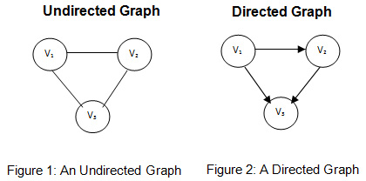
Types of networks (graphs)
Networks can be many types but two of those are listed here..
Directed Graph b) Undirected Graph
Notes:
Okay, so now let me talk about types of networks, as I've already discussed that there can be various different types and in fact there are a huge number of types of networks, but I'm only talking about directed and undirected networks or undirected graphs and also I would like to give you an example of each of those types of graphs. So if I talk about directed graphs. Twitter is an example, which can generate directed graph data, whereas Facebook is a example which can generate undirected graph, and the real meaning of this is that, say for example I'm having two users end. Now there is no concept of following on Facebook because he cannot follow BB cannot follow, they can only become friends, whereas on the other hand, in the case of Twitter. He can follow B, but b cannot follow a, and he can, or he cannot, it's his choice. So, essentially, we can have an arrow like representation which which kind of represents and captures the meaning of direction. So, in this example only in this example that is listed here on this slide here, we can we can clearly see. V1 is not followed by anyone but v3 is followed by both v2 and v1. So, this is a directed graph.

Slide 7
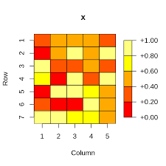
Visualization of a network
Network Diagram where each object (node) is represented as a circle and each relationship is represented as arrow or line depending upon whether the network is directional or not.
Matrix Plot: It is a plot where each node is written in columns and as well as in rows and then each cell is filled in if there is a connection between those two nodes.
Notes:
In the last slide, what we talked about was different types of networks or graphs that we could possibly have. In this slide, I would like to talk about various different types of visualizations methods that a particular network could have, again, just like types of networks. We can have different, and in fact there are a number of different visualizations type of visualization types of a network. But we are not going to be discussing all of them, we are going to be discussing, two of the very simple visualizations, and they are very intuitive they're very easy to understand. The first one which is network diagram gets a little bit messy and distorts the comprehension of the network. When the number of nodes gets really huge. In number. Okay so that is why network diagram sometimes are ignored for huge data. So, the way network diagram works, is exactly same as we have discussed in the previous slide, in the previous slide you saw the graph of directed and undirected network diagram. Okay. So, essentially what we do is we represent each object of our graph as a circle. So each node will be represented as a circle, and depending upon the type of the network whether it is directional or not, we will represent and connect those nodes. The relationship between those nodes in the form of arrow or line. Okay, so I hope you are this particular point.
The second visualization method that I have listed here is known as matrix plot in the matrix plot, what we do is we put all the nodes in each row and in each column. And now we will have a circular or square representation, where each cell will represent the intersection of two nodes. Okay, so what we do is we ask ourselves whether there is a connection between two nodes. If there is, then corresponding to that cell, what we do is we highlight more colors color in that particular cell where there is a relationship between those two cells. Okay, so then when the and this type of plot will be completed. We will get a get a picture where all the, all the relationship lies. And, yeah, so this is what we mean by matrix plot.

Slide 8
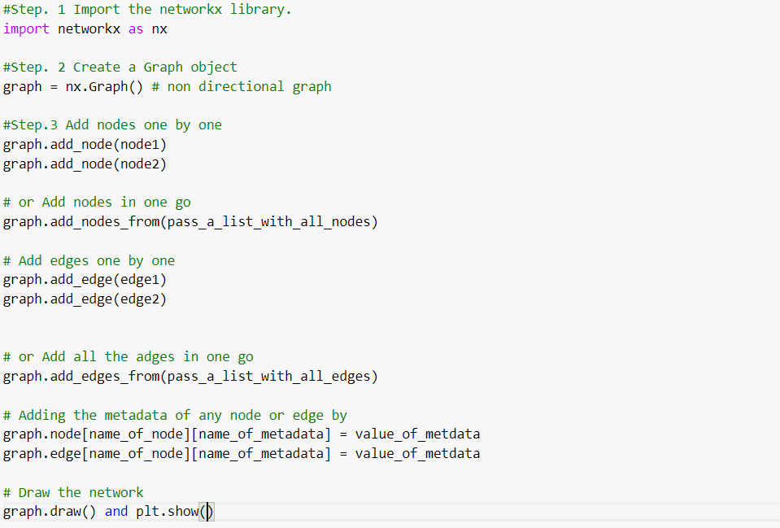
Networkx library for doing network analysis
Notes:
So on this slide. What I have done is I have tried to give you an idea, and also try to give you a sequence of procedures that should be followed to use network as network x library, and this library is a very powerful and network analysis library, using which we can create graphs, add nodes and add edges in a very quick manner. Unlike other libraries which are very difficult to understand and the learning curve is quite steep, but for network x. The their API is quite easy and very intuitive to understand okay so everything is listed on the slide itself. First of all, how can we import the library, how can we create a graph object, and also the graph object that I have imported in particular is a non directional graph, whereas we can have other late, other graphs like directional graph for that for that we will have to use an x dot d graph. Plus, okay. And I have also shown how can we add nodes and add edges. Both one by one, and both in one. So, I've shown you two methods of adding nodes and edges. The first one is adding a nodes, one by one, adding edges one by one and adding nodes in one go by passing a list and then I've shown you how can you add metadata associated with a node and edge. Okay, So I hope you got this particular point.

Slide 9
Importance of a node (degree)
I want to answer a questions like “Which node is the most important node in the network?” and also “How important it is in comparison to other nodes?”
There are various metrics of importance out there but one of the most intuitive and most easy to understand is “Number of neighbours a node has”
Higher the number, higher the importance.
Let us see how to check the importance of a node in networkx library
Notes:
Now that we understand how does network x library works. Now we will be starting to talk about importance of a node in our graph, or in our network. So, if you ask anybody who is not aware of the concept of network. And if you show them a network with a node, in which, various different types of connections are happening. And if you ask him what do you see in this network. And how do you tell which node is most important node, then obviously, that individual will will most likely be answering a node, in which most of the connections are taking place. So that is the, that is what the precisely the concept of degree to compute the degree, what we have to do is we have to compute how many number of neighbors, a particular node has the larger the number of neighbors a particular node has, we will see intuitively that that node is most important in a network or in a graph. Okay, so this was a concept of degree where we compute number of neighbors.

Slide 10
Importance of a node continued (degree centrality)
What we just seen was an example of “degree” of a node?
Degree of a node is defined as the number of neighbors a node has.
Degree centrality is another metric which is computed after dividing the degree with the maximum number of node that a node could possibly have.
Notes:
On the other hand, we can also compute what is known as degree centrality, and with degree centrality what we do is we try to normalize the degree. And what does degree mean, in the previous slide we talked about degree as the number of neighbors, a particular node has now. We can also have something like number of possible nodes that a particular node could have. So if I divide the number of actual neighbors, divided by number of number of neighbors that a node could possibly have. Then what I get is known as degree centrality, again, the more the degree centrality the more important a particular node will be.

Slide 11
Path finding problem
What else can we do in network analysis apart from node importance that we just discussed?
There is one more concept which is very popular in transportation networks and that problem is to find the shortest path in a network.
So, the question is..
“How can i reach from node 1 to node 2 in a minimum number of steps?”
Notes:
Now let us switch gears and let us talk about something, a very different topic. Different than node importance.
The topic is pathfinding problem in our network in our graph, we can also have a problem of finding the shortest path. And this precise problem is what is faced by transportation network, like, obey might be facing this problem of finding the shortest path. So, this is what we mean by pathfinding problem. Okay. On the next slide, we discuss about BFS algorithm and BFS algorithm is a standing for breadth first search algorithm, which is one of the earliest algorithm which is used for finding the shortest path for for getting to a particular node, starting from a particular node. So, given two nodes. What breadth first algorithm does is, it finds the shortest path from those two nodes, getting from first node to another note. Okay.
The topic is pathfinding problem in our network in our graph, we can also have a problem of finding the shortest path. And this precise problem is what is faced by transportation network, like, obey might be facing this problem of finding the shortest path. So, this is what we mean by pathfinding problem. Okay. On the next slide, we discuss about BFS algorithm and BFS algorithm is a standing for breadth first search algorithm, which is one of the earliest algorithm which is used for finding the shortest path for for getting to a particular node, starting from a particular node. So, given two nodes. What breadth first algorithm does is, it finds the shortest path from those two nodes, getting from first node to another note. Okay.

Slide 12
BFS algo for Path finding
BFS algo is one of the earliest algorithms for path finding and it quite intuitive.
So, let us say we want to reach from node A to node B, we will start from node A and look at its neighbors and ask
Is node B present? If yes, stop else
Loop over all the neighbours of node A and check their neighbors and this steps keeps going recursively until we hopefully get to node B
Notes:
Now let us talk about how does BFS algorithm actually works. So, in BFS algorithm the input will be three things. The first one will be the graph. The second one will be the starting node, and the third one will be the desired note that they would like to reach. So, what we do is we first of all, start from the node A, and we compute all the neighbors of node A. And then we see and ask ourselves this question that does the node B, our desired node exist in the neighbors of node A. If it does, then we will stop right there. And if it does not, then we will continue on searching for all the neighbors of the neighbors of node A, and we will do this particular step recursively until we find the node B in the neighbors of successive nodes. Okay, so I hope you got this particular algorithm.

Slide 13
Task for you.
Make a hypothetical Network of Social Media Platform and make some 50 + nodes for people with their metadata. You could do this manually or get some data of people from Internet.
After that, define some edges between these people. Try to define at least 20 + edges.
After that, try to compute the degree and degree centrality.
Try implementing the BFS algo and try to find some shortest paths. Does they tell you anything about the node in general?
Notes:
So on this slide. what I have done is I have created some set of fourtasks for you. So the tasks goes as follows The first one is a mega, mega hypothetical network of social media platform. And here I want all of you to make at least 50 plus nodes for people. So each node will represent a people, and also add some metadata associated with that. With each of those people. Now, if you are not interested in adding and doing this manually. What you could do is you could scrap or find some, some online data which gives you a detail of, say for example 60 people, and you can just import that data using pandas. And you can loop through all the rows and add, add all these different information in a network using network x library. Okay, so the second task is define some edges. Now here you have to use some tricks to define at least 20 plus edges. Okay. And after that you have to compute degree and degree centrality, both of which we have discussed in the video and also the final task for you will be try implementing the BFS algo and try to find some shortest paths. Okay. And also, there is a very tricky challenge for you, does that tell you anything about the nodes in general. So when, when you get the shortest path, then you have to ask yourself this question that does this particular short path, tell me anything about nodes in general.

Slide 14
Thank you

